Slide 1
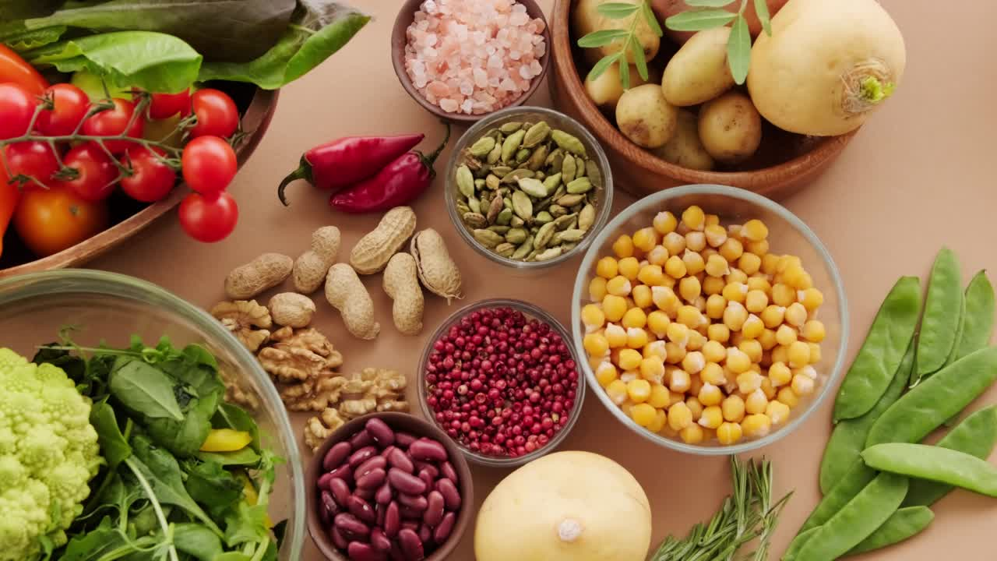
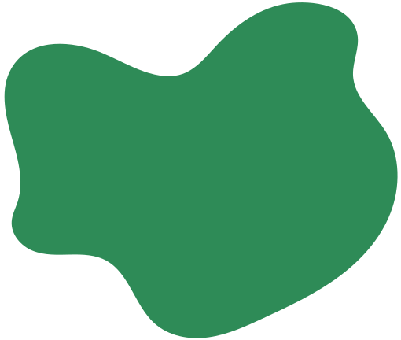
NUTRIBOT
Smart Nutrition Assistant for Personalized Dietary Support
By : Ghala Al-Otaibi

Slide 2
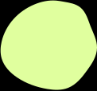
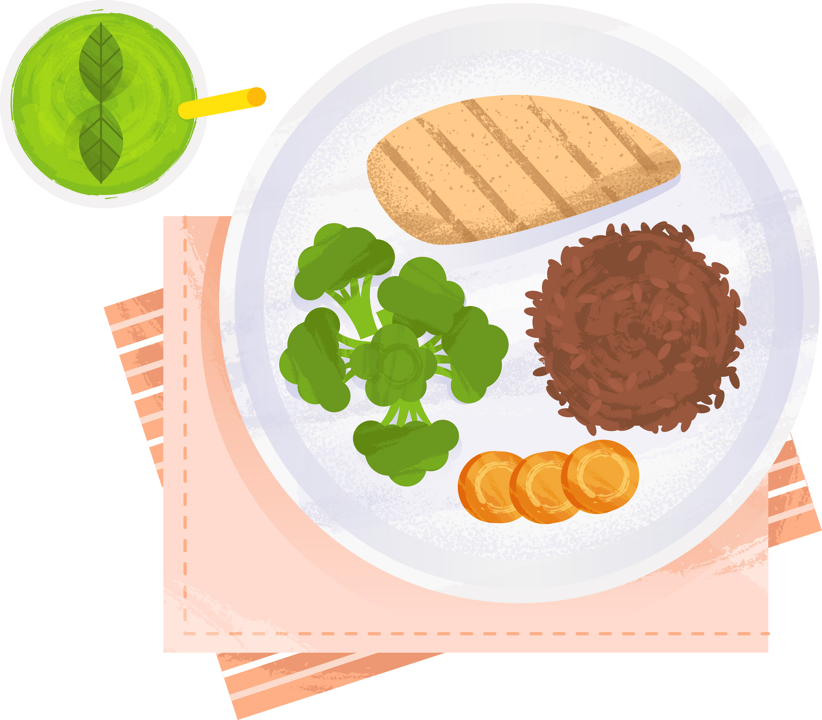

LIST OF CONTENT
Introduction
Architecture
Design
Evaluation
Challenges
Conclusion

Slide 3
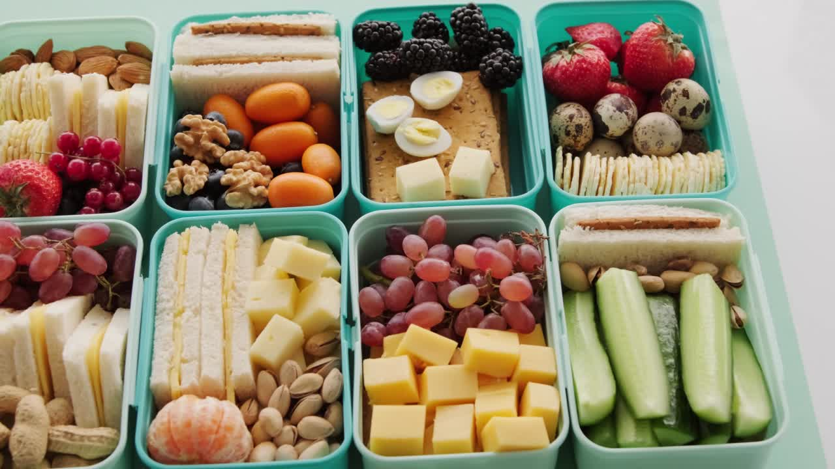
INTRODUCTION

Slide 4
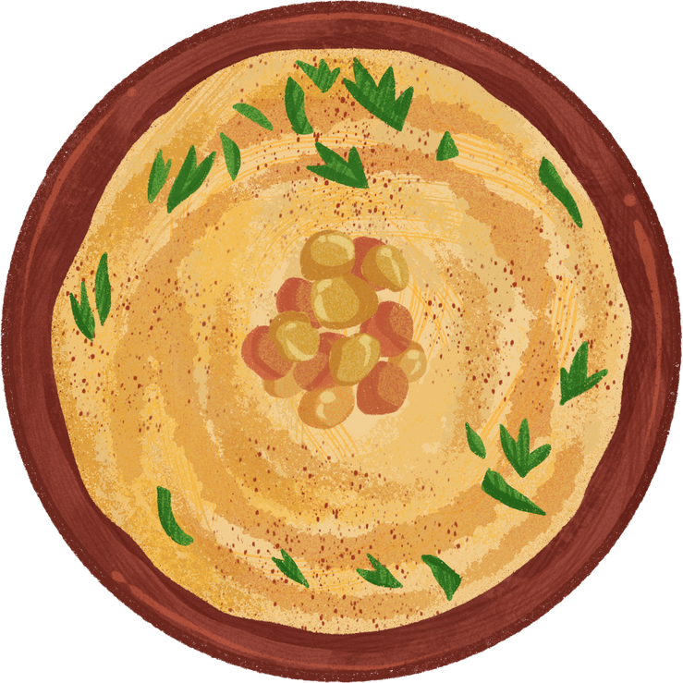
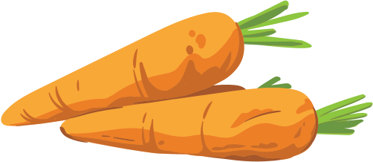
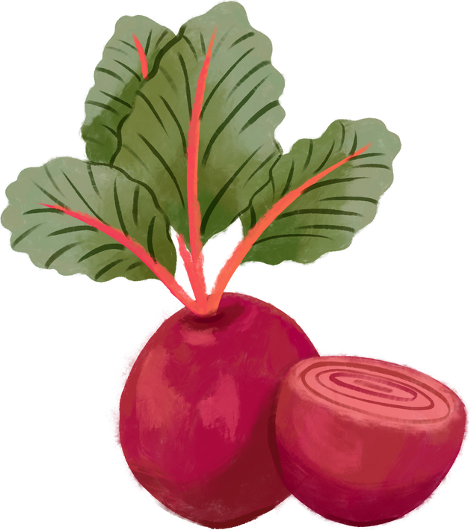
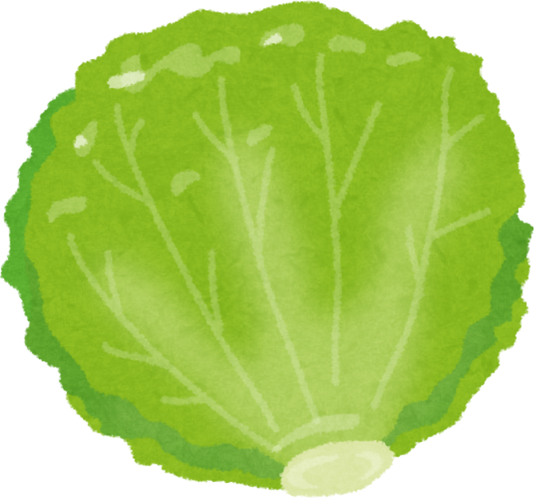
WHAT IS NUTRIBOT?
Overview:
Purpose:
NutriBot is an AI-powered nutrition assistant designed to provide personalized dietary support
Help users make informed food choices based on their health conditions and nutritional needs

Slide 5
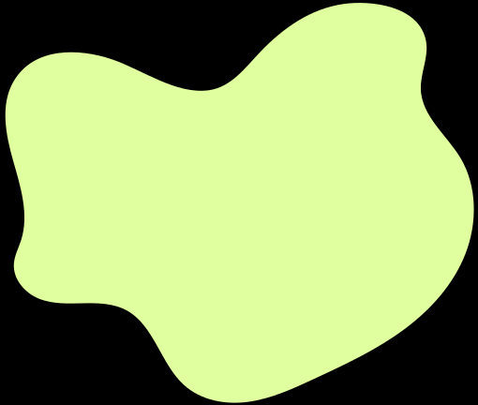
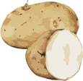
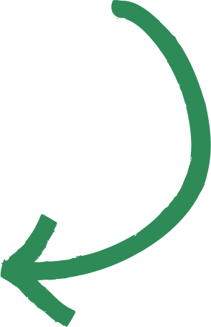
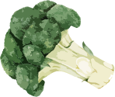
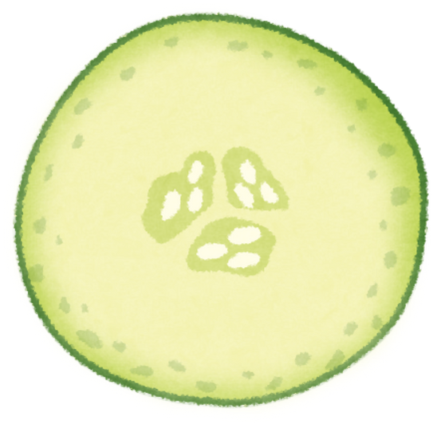
Multimodal Input:
Text, voice, image
personalized health advice
KEY FEATURES
evidence-based answers
Arabic and English language support

Slide 6
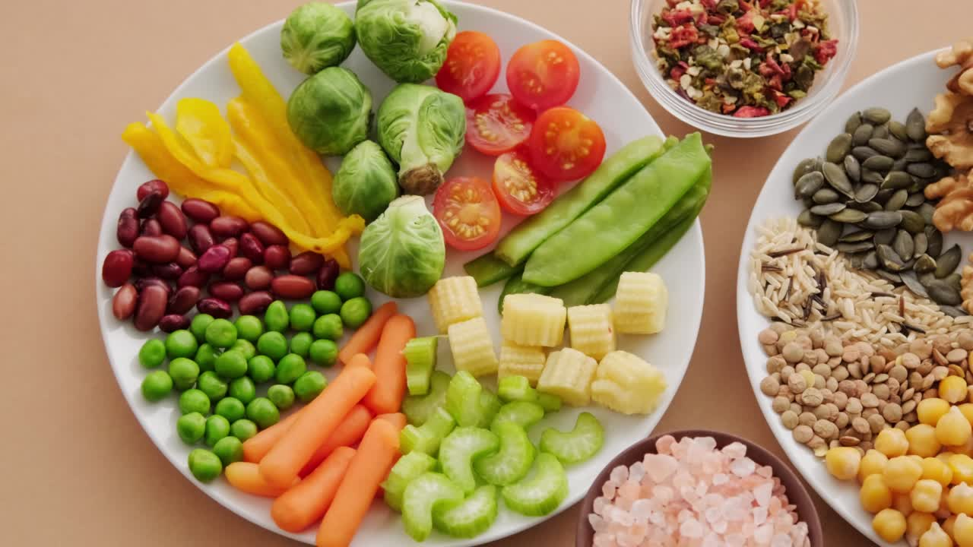
SYSTEM ARCHITECTURE & DESIGN

Slide 7
SYSTEM COMPONENTS
Input:
Text / Voice (Whisper) / Image (BLIP)
Knowledge Base:
Extracted from 3 clinical nutrition books as PDF format
Retrieval:
ChromaDB + OpenAI Embeddings
LLM:
GPT-4o with memory (ConversationBufferMemory)
Output:
Gradio chatbot

Slide 8
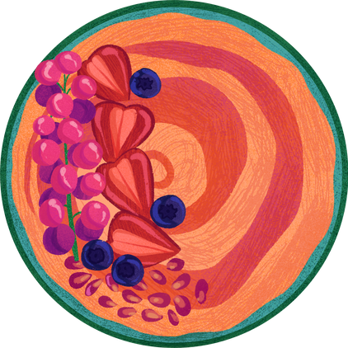
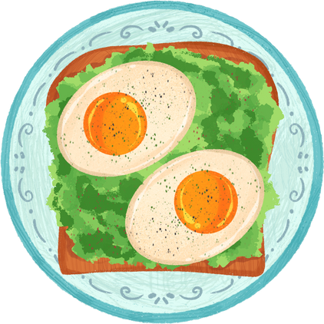
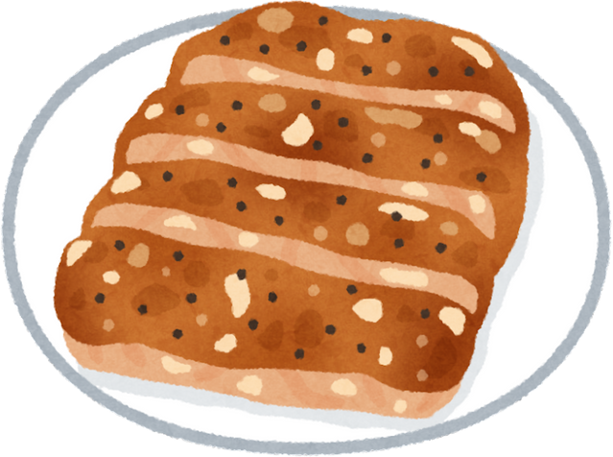
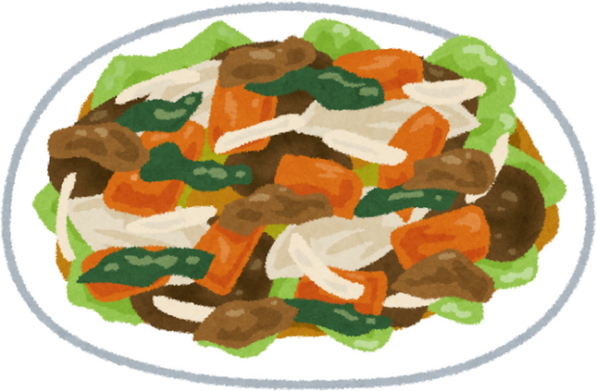
DATA SOURCES & MULTIMODAL PROCESSING
Sources:
3 clinical nutrition books (PDFs)
Types: Disease management, diet guidance, pathophysiology
Tools:
PyMuPDF for parsing, LangChain for chunking, OpenAI for embedding
Input Types:
Text: Direct questions
Voice: Whisper (Arabic/English)
Image: Food recognition via BLIP
Processing:
Translation (Google Translator)
Context retrieval via ChromaDB
Answer generation with context via GPT-4o

Slide 9
PERFORMANCE & EVALUATION

Slide 10
PERFORMANCE EVALUATION BY LANGSMITH
The model was evaluated using the LangSmith platform, which provided detailed insights into response relevance, hallucination, latency
Question | Answer | Relevance | Hallucination | Latency (s)
Best healthy breakfast for hypertension? | For someone with hypertension, a healthy breakfast could include foods that are low in sodium and rich in potassium, magnesium, and fiber.... | True | False | 3.11
Can plugging your ears help reduce sugar levels? | No, plugging your ears does not have any effect on blood sugar levels.... | True | False | 1.72

Slide 11
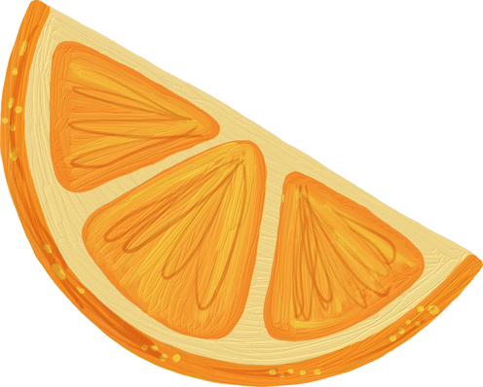
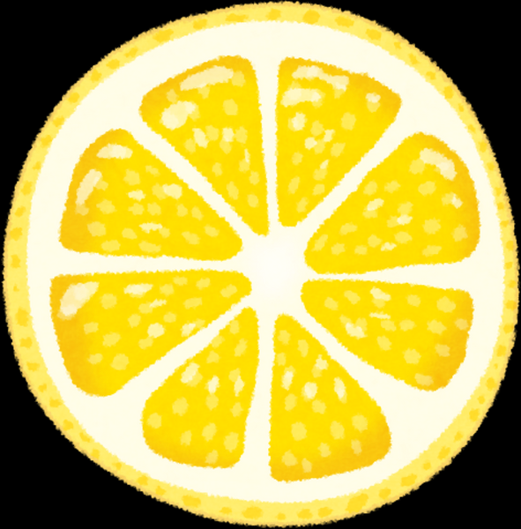
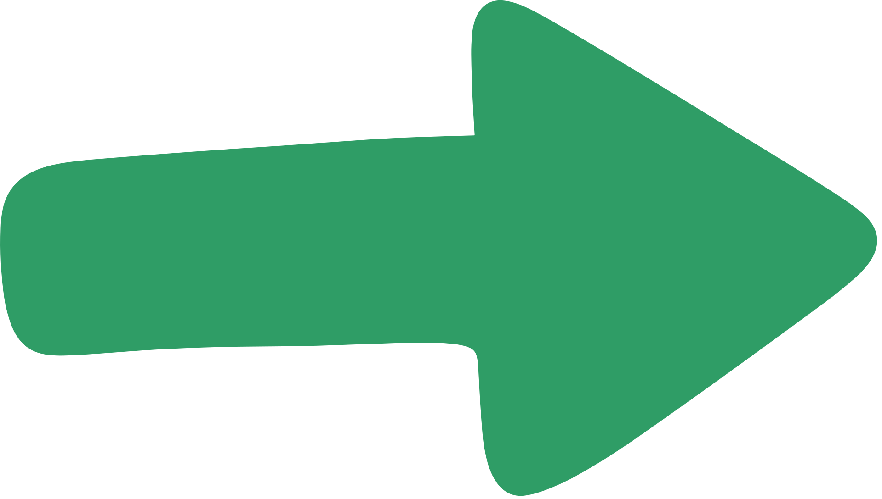
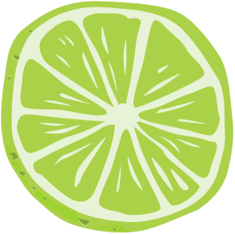
CHALLENGES & SOLUTIONS
Challenges
Solutions
Accurate Arabic Speech Recognition
Use large version of Whisper
Strict Prompt Template, Post-Answer Filtering
Reducing Hallucinations
Translating Medical Terminology to Arabic
Integrated Google Translator

Slide 12
CONCLUSION & FUTURE WORK

Slide 13
CONCLUSION & FUTURE WORK
Conclusion
Future Work
NutriBot is a smart, scalable, multilingual assistant
Built on trusted clinical sources
Solves accessibility and personalization issues
Add structured diet plans based on diagnosis
Expand to more languages (e.g., French, Spanish)
Mobile-first UI

Slide 14
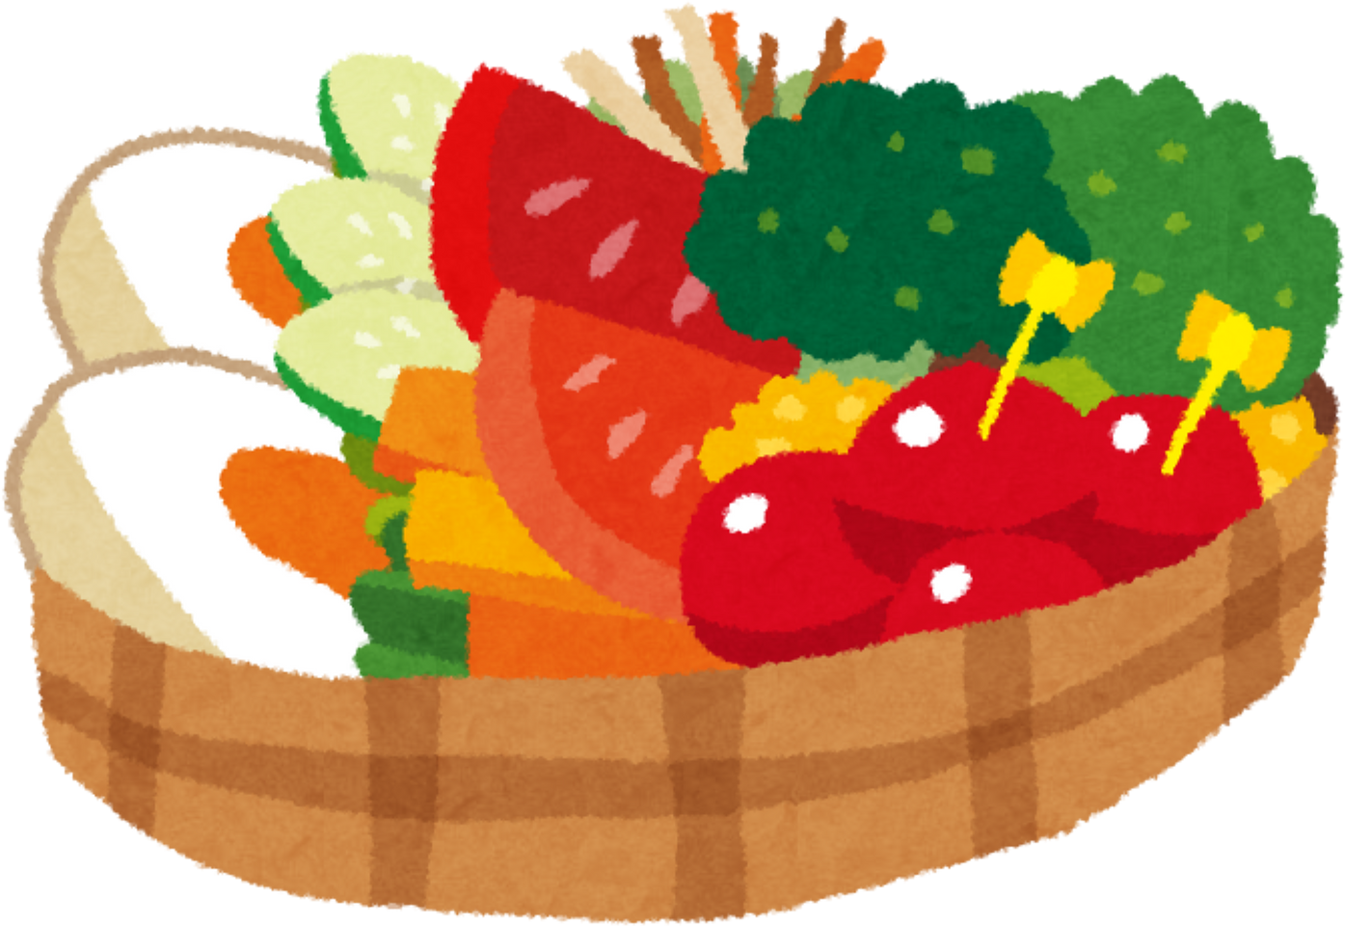
THANK YOU

